Slide 1
Restaurant presentation

Slide 2
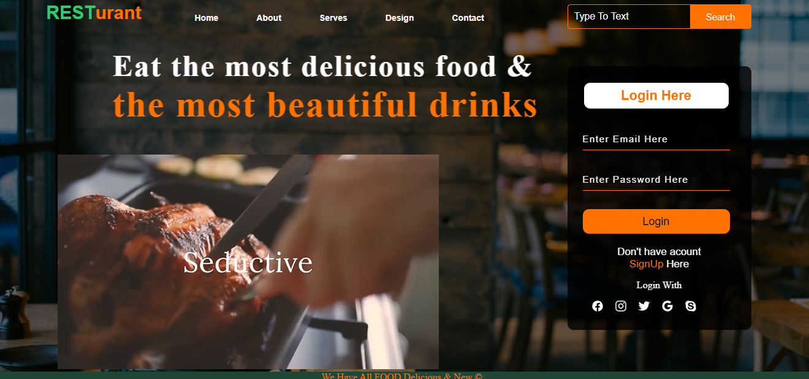
Home page
Home Page
Through it, the user can create a new account, or if he has already registered, he can log in directly to the website page, and the user can also register through social networking sites such as Facebook, Instagram, and also Gmail

Slide 3
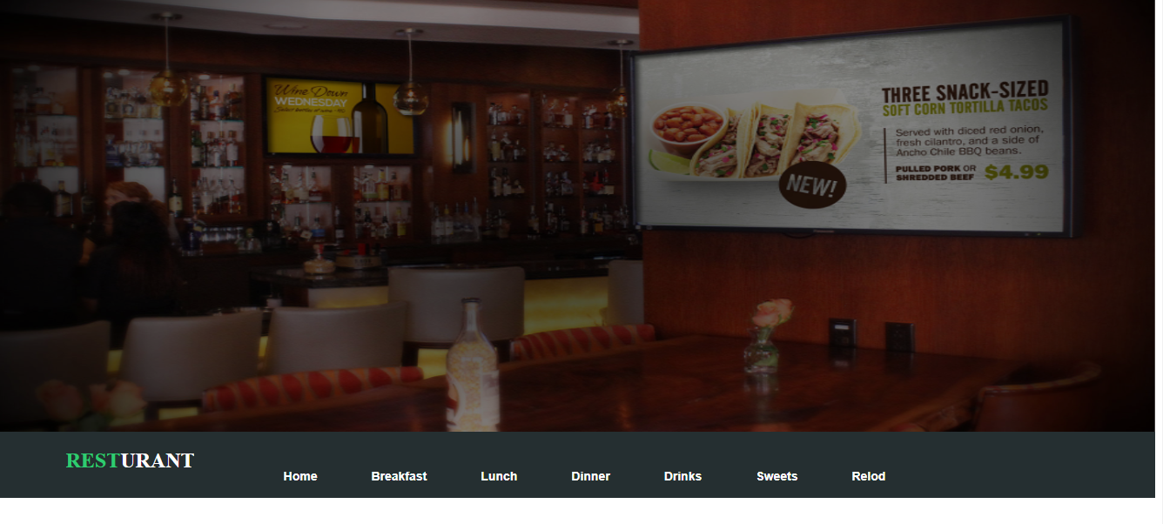
Frist page
Frist Page Through it, the user can determine what he wants, whether he wants breakfast, lunch, dinner, some sweets or drinks

Slide 4
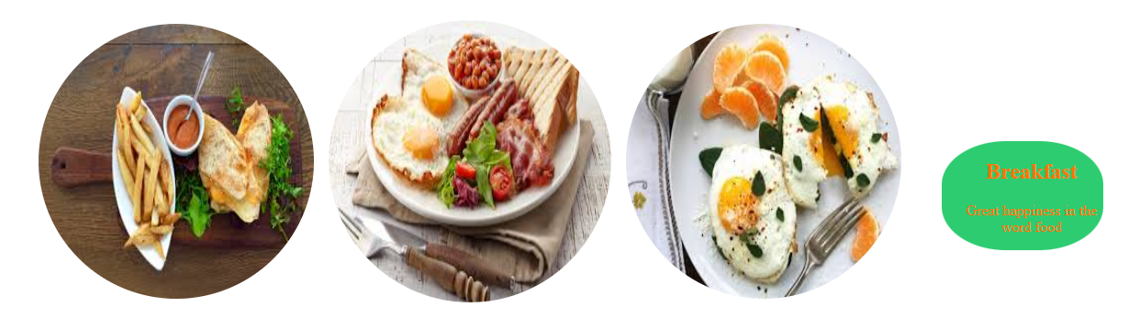
Brakfast section
User if he wont to eat a breakfast he well click on “Breakfast” link to shoos what he can eat in the breakfast

Slide 5
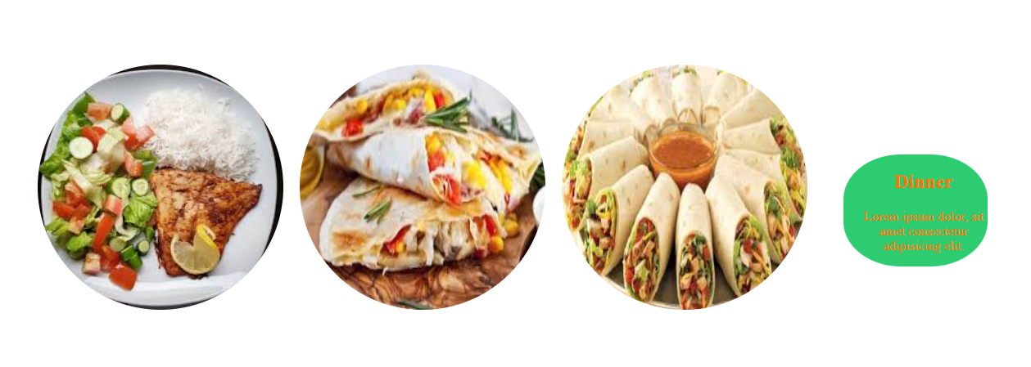
Dinner section
User if he wont to eat a Dinner he well click on “Dinner” link to shoos what he can eat in the Dinner

Slide 6
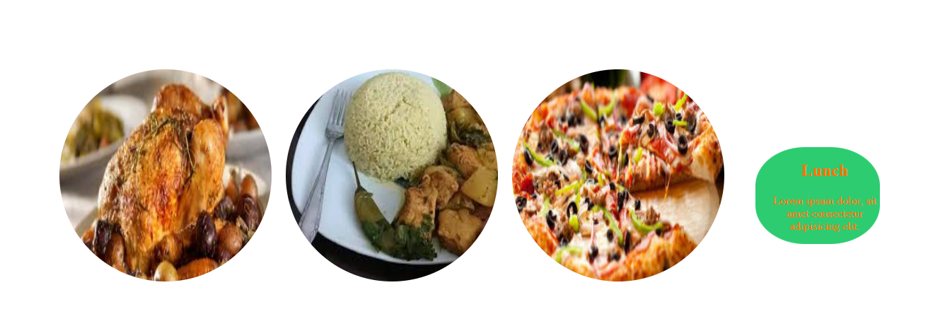
Lunch section
User if he wont to eat a Lunch he well click on “Lunch” link to shoos what he can eat in the Lunch

Slide 7
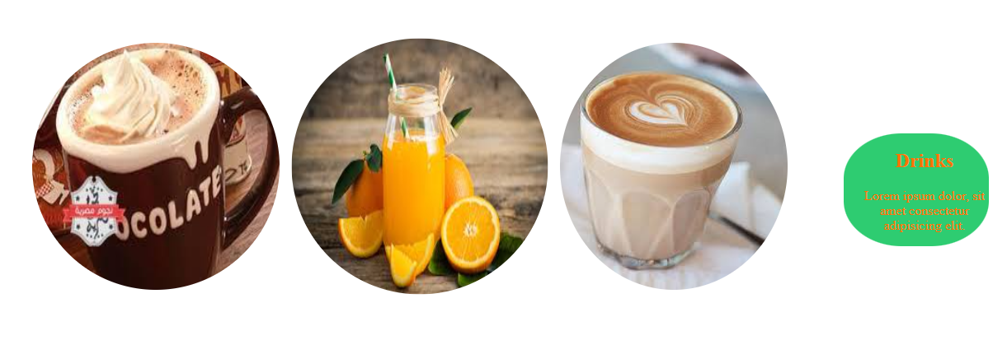
Drinks section
User if he wont to Drank Something he well click on “Drinks” link to choose what he can Drink in any Time

Slide 8
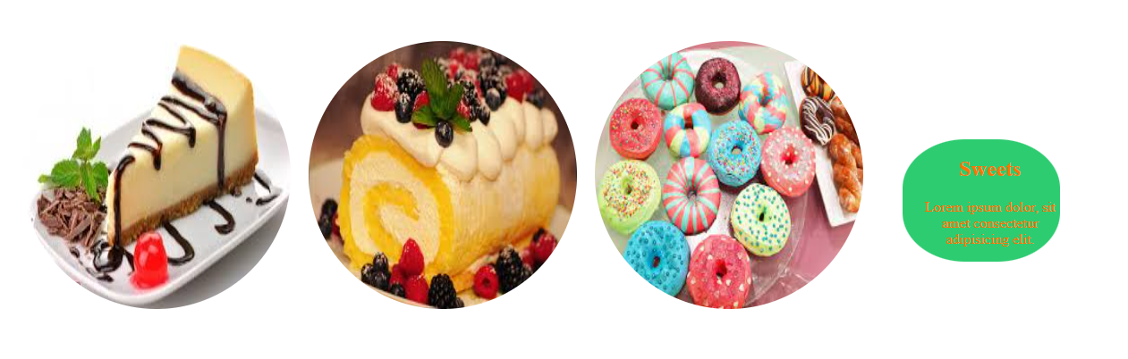
Sweets section
User if he wont to eat Some of Sweets he well click on “Sweets” link to choose what he can eat form that’s Sweets in any Time

Slide 9
Thanks

